Slide 1


FITEC
Automatic Classification of Plutonic Rocks with Machine Learning Applied to Extracted Shades and Colors on iOS Devices
Sarah Hernández Serrano
Asesor: Dr. Germán Harvey Alférez Salinas
Asesores secundarios: Dr. Benjamin L. Clausen y Dra. Ana María Martínez Ardila
04 de mayo de 2021
UNIVERSIDAD DE MONTEMORELOS
FACULTAD DE INGENIERÍA Y TECNOLOGÍA

Slide 2




TABLE OF CONTENTS
Introduction
Theoretical Foundation
Results
Conclusions & Future Work

Slide 3

Introduction
Background
Problem Statement
Justification
Objectives
Hypothesis

Slide 4
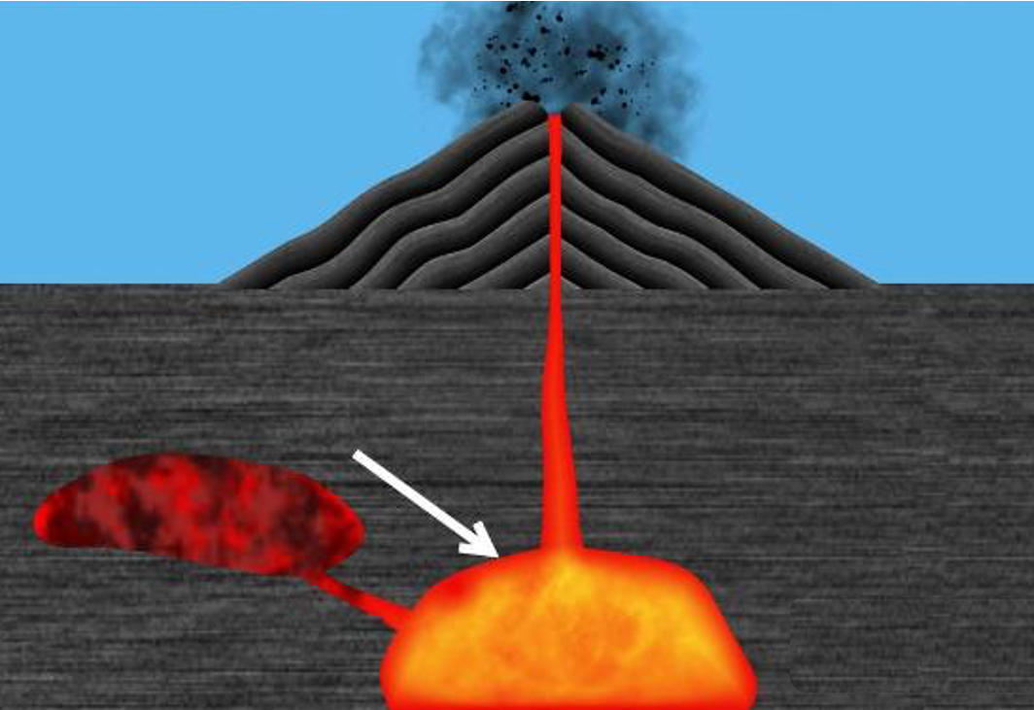
Introduction
Background
Plutonic rocks are formed when magma cools and solidifies below the Earth’s surface.
Lightness and color are properties used for the classification of plutonic rocks.
Notes:
Plutonic rocks are formed when magma cools and solidifies below the Earth’s surface. Lightness and color are properties used for the classification of plutonic rocks. Color changes in rocks may indicate changes in the rock’s mineral assemblage, texture, organic carbon content (shales), or other properties [1]. That is why color is a key property for rock classification.
Our contribution is fourfold. First, we used pictures of plutonic rocks that had been classified using petrography and chemistry data. The dominant colors of plutonic rock images were extracted with the K-means algorithm by grouping the image pixels according to the RGB (Red, Green, Blue) and CIELAB (or LAB) color spaces. Second, the data of the four dominant colors were used to create and evaluate several machine learning models for the automatic classification of four classes of plutonic rocks in order from darker to lighter: gabbro, diorite, granodiorite, and granite. The models were generated with the following algorithms: a Convolutional Neu- ral Network (CNN), Decision Trees (DT), K-Nearest Neighbors (KNN), Logistic Regression (LR), and Support Vector Machines (SVM). Third, the best model in terms of accuracy, precision, recall, and F-score was deployed after validation on an iOS application that classifies the extracted colors in new images of the four rock types. Fourth, we compared the best model evaluation results of our approach with the CNN of our previous work [2] that was trained with the same dataset of plutonic rocks using the whole set of image pixel features instead of the four dominant colors.

Slide 5
Introduction
Problem Statement
The instruments for accurate rock classification are expensive making it prohibitive for geology students and amateurs.
There is a lack of mobile tools for plutonic rock classification using machine learning.
Notes:
The instruments for accurate rock classification are expensive making it prohibitive for geology students and amateurs. In addition, there is a lack of mobile tools for plutonic rock classification in the field using machine learning. Moreover, despite the fact that shade and color are significant properties for rock classification, these attributes are difficult to describe because perceived shades and colors in rocks depend on the observer’s experience [1].

Slide 6
Introduction
An iOS mobile application that classifies plutonic rocks with machine learning using their dominant colors does not exist. It offers the flexibility to carry out the classification in real time.
Justification
Verify if this approach with dominant colors leads to better results than the obtained in our previous work [2].
Notes:
There are two reasons to create an iOS mobile application that allows the classification of plutonic rocks with machine learning using their dominant colors. The dominant colors represent the principal color values of all the pixels in an image. First, no such application exists. A mobile application offers the flexibility to carry out the classification in real time and could be an alternative to expensive traditional methods of rock classification. Second, we extracted the dominant colors to verify if feature reduction leads to better results than the obtained with the CNN of our previous work [2] that was trained using all the image features.

Slide 7
Introduction
Extract dominant colors from plutonic rock images to train several machine learning algorithms and deploy the best model in an iOS application.
Objectives
Extract colors
Train the models
Validate
Compare
Determine the best k number of clusters to use in K-means to extract the dominant colors in terms of RGB and CIELAB
from 283 images of plutonic rocks
Use the extracted dominant colors to train the following machine learning algorithms: LR, KNN, DT, SVM,
and CNN.
Validate the models and deploy the
best model in an
iOS mobile
application.
Compare the best model results with the obtained in
our previous
work [2].
Notes:
The main objective of this research work is to extract dominant colors from plutonic rock images to train several machine learning algorithms and deploy the best model in an iOS application. The model evaluation results are compared to the model of our previous work [2]. This objective is achieved with the following sub-objectives:
• Determine the best k number of clusters to use in the K- means algorithm to extract the dominant colors in terms of RGB and CIELAB color spaces from 283 images of plutonic rocks.
• Use the extracted dominant colors and the percentage of pixels belonging to each color cluster as the input to train the following machine learning algorithms: CNN, DT, KNN, LR, and SVM.
• Validate the generated models by means of the accuracy, precision, and recall metrics. The best model is deployed in an iOS mobile application.
• Compare the best model validation results with the CNN of our previous work trained with the whole set of rock image features.

Slide 8
Introduction
Hypothesis
A machine learning model trained with just the dominant colors extracted from gabbro, diorite, granodiorite, and granite images can provide an effective way to classify these plutonic rocks on iOS devices.

Slide 9

Theoretical Foundation
Underpinnings of our Approach
Related Work

Slide 10
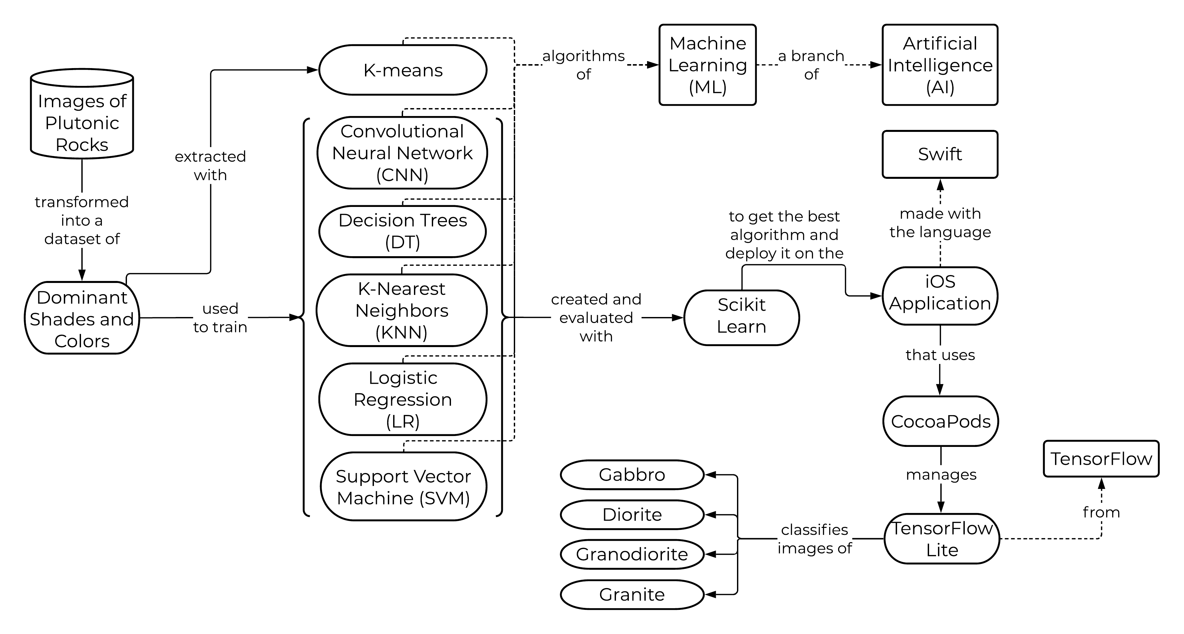
Theoretical Foundation
Figure 1. Underpinnings of our Approach
Notes:
Our approach is based on the following concepts (see Fig. 1).

Slide 11
Theoretical Foundation
Related Work
Table 1. Comparison of the articles described in the related work
Author | Year | Dataset | Algorithm of Extraction | Extracted features | Dataset for training | Best trained model | Results
E. L. Vázquez et al. [2] | 2020 | 423 patches from 71 images of six plutonic rock types (gabbro, diorite, tonalite, monzodiorite, granodiorite, and granite) |  |  | Augmented data from the patches | 4-layer structure CNN | Accuracy: 95%, Precision: 96% Recall: 95%, F-score: 95% Training time: 2 hrs Execution time: 353.74 ms File size: 2.6 MB
Fan et al. [18] | 2020 | 3,208 images of 28 rock lithology categories |  |  | 80% of the images | SqueezeNet | Accuracy: 94.55% File size: 9.2 MB Execution time: from 736 to 366 ms
Fan et al. [19] | 2020 | 3,795 images of 30 different rock types |  |  | 80% of the images | Shuffle Net | Accuracy: 95.30% File size: 18.2 MB Execution time: 786 ms
Ran et al. [20] | 2019 | 14,589 patches from 2,290 images of six rock types (granite, limestone, conglomerate, sandstone, shale, mylonite) |  |  | 60% of the patches | 3-layer structure CNN | Accuracy: 97.76%
Zhang et al. [21] | 2019 | 481 images of four minerals (K-feldspar, perthite, plagioclase, and quartz) | Inception-v3 CNN model | High-level features (such as chromatic aberration and texture) | 90% of extracted features | Stacking model (LR, SVM, and MLP) | Accuracy: 90.9%
Maitre et al. [22] | 2019 | 3,192 sub-images of the views of a surface taken at different angles to a surface with 27 mineral grain species | Simple Linear Iterative Clustering (SLIC) algorithm | Color intensity and Peak intensity of computed histograms from superpixels | 70% of extracted features | Random Forest (RF) | Accuracy: 89%
Cheng and Guo [23] | 2017 | 4,200 images of three feldspar sandstone rock types (coarse, medium granular, and fine) |  |  | 75% of the images | 6-layer structure CNN | Accuracy: 98.5%
Notes:
Machine learning has been an effective way for image classification in geochemistry. Specifically, feature reduction was applied in [21, 22] using deep learning and the simple linear iterative clustering (SLIC) algorithm to extract high- level features from images of mineral samples before training the machine learning models. Although these works showed good results in the classification of mineral samples, the number of extracted features was very large.
Four articles [18, 19, 20, 23] introduce CNN topologies and analyze the performance of the models generated for rock lithology classification using all the image features. Also, in our previous work [2], several combinations of plutonic rock images of 4 classes were analyzed using all the image features to train a CNN model rather than extracted features. In [2, 18, 19] the created models were deployed on an Android mobile application for the classification of rocks. However, there are no works presenting the deployment of machine learning models on iOS devices.
Finally, the evaluation of the models in [18, 19, 20, 23] showed good results in the classification of rock lithology. Nevertheless, all of them were trained with diverse types of rocks instead of plutonic rocks. Classification of one rock type becomes more difficult because rocks of the same type have very similar characteristics.

Slide 12

Results
Methodology
Results
Discussion

Slide 13
Results
Getting the images of the plutonic rocks
Preparing the data
Determining the best number of color clusters
Color extraction
Data normalization and label encoding
Training the different algorithms with the extracted dominant colors
Creation of the iOS application
Methodology
Notes:
This section describes the steps followed in this research work.

Slide 14

Results - Methodology
1. Getting the images of the plutonic rocks
The images of plutonic rocks were provided by the Department of Earth and Biological Sciences at Loma Linda University. We used pictures from plutonic rocks that were classified by using petrography and chemistry data.
Class | Number of images
Diorite | 78
Gabbro | 65
Granite | 70
Granodiorite | 70
Total | 283
Notes:
The images of plutonic rocks were provided by the Department of Earth and Biological Sciences at Loma Linda University. We used pictures from plutonic rocks that were classified by using petrography and chemistry data. Specifically, the dataset contains 283 image patches selected from the 81 original images of four classes of plutonic rocks: diorite, gabbro, granite, and granodiorite. In the experiments we used clean rock samples with negligible weathering or alteration visible to the naked eye. The images used in the following experiments were organized in subfolders according to their class and are available online6. Table II shows the number of images per class.

Slide 15

Results - Methodology
2. Preparing data
In this step, the images were processed in order to obtain the color values of the image pixels in RGB and CIELAB color spaces.
First, all the files in the subfolders were processed in RGB format and labeled according to their container subfolder.
Afterwards, the RGB values of the image pixels were converted to CIELAB values.
Notes:
In this step, the images were processed in order to obtain the color values of the image pixels in RGB and CIELAB color spaces.
First, all the files in the subfolders were processed in RGB format and labeled according to their container subfolder (e.g. images in the granite subfolder are labeled as granite). Afterwards, the RGB values of the image pixels were converted to CIELAB values using the “rgb2lab” function of the “color” class of the Scikit-image module. In this way, it is possible to train the models in the two color spaces and determine which color format is the most appropriate for classifying the dominant colors of the 4 classes of plutonic rocks. The notebook with the source code for data preparation is available online7 .

Slide 16

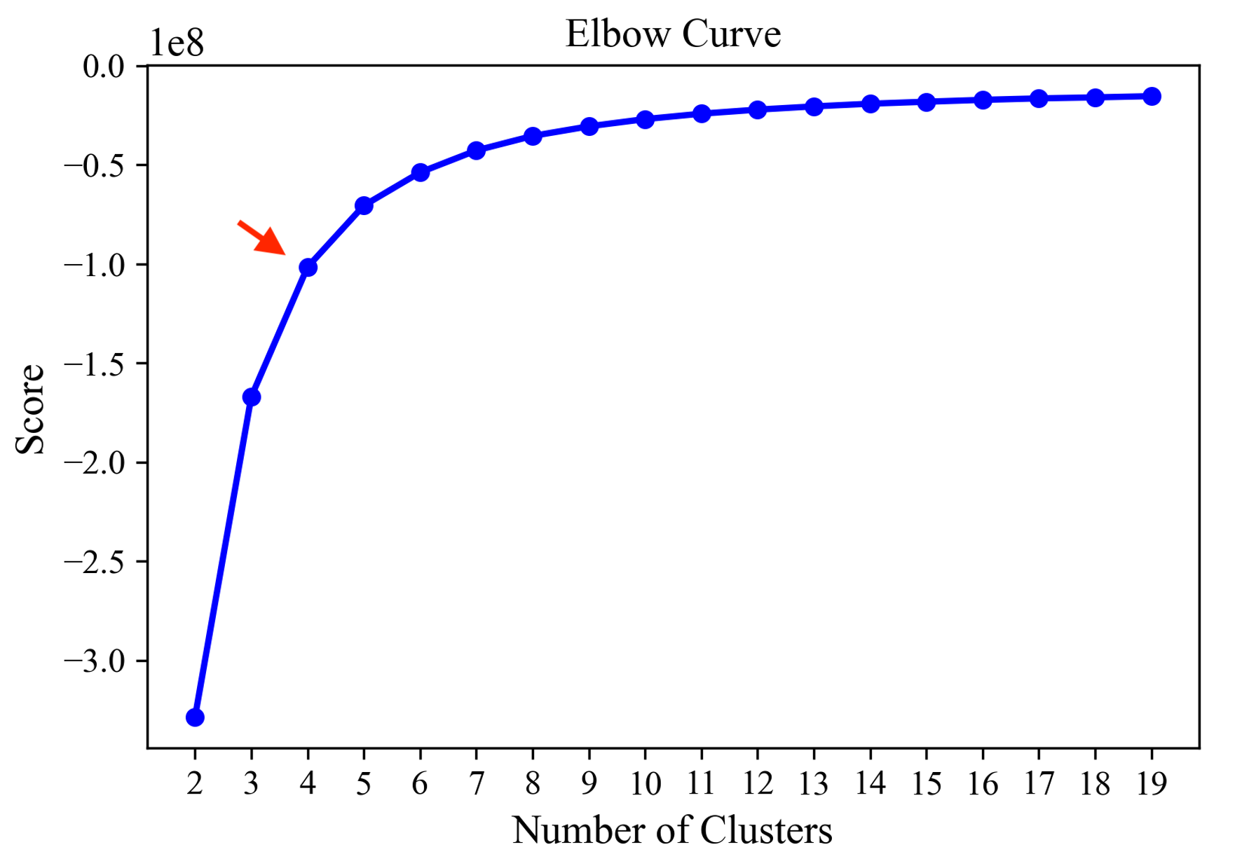
Results - Methodology
3. Determining the best number of color clusters
The Elbow method was used to calculate the optimal k number of clusters to use by K-means.
The number at the elbow in the plot indicates the best k number of clusters, which is 4 for this experiment.
Figure 2. The Elbow method returned the optimal
Notes:
The K-means algorithm was used to extract the dominant colors from the images. Also, the Elbow method was used to calculate the optimal number of clusters k to use by the K- means algorithm. This method consists of iterating in a range of possible cluster numbers and determine the best one. The k value ranged from 2 to 20 was declared to obtain the scores of K-means at each cluster number. Finally, we plotted the scores with their respective k number. The number at the elbow in the plot indicates the best k number of clusters, which is 4 for this experiment (see Fig. 2).

Slide 17
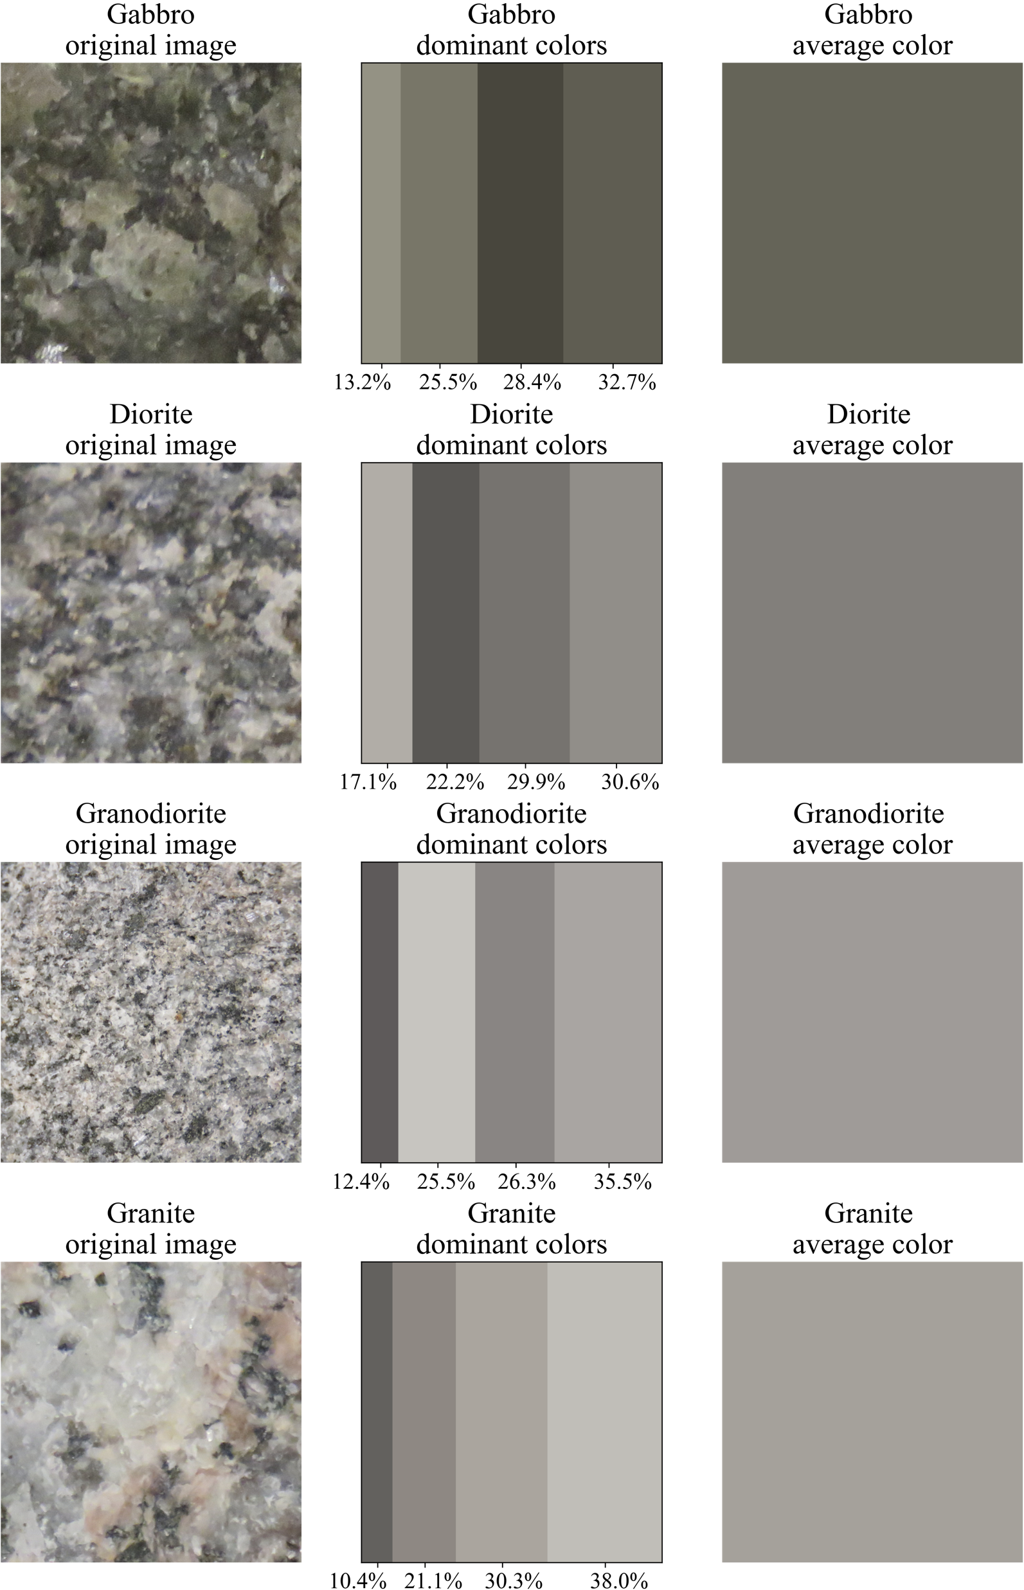

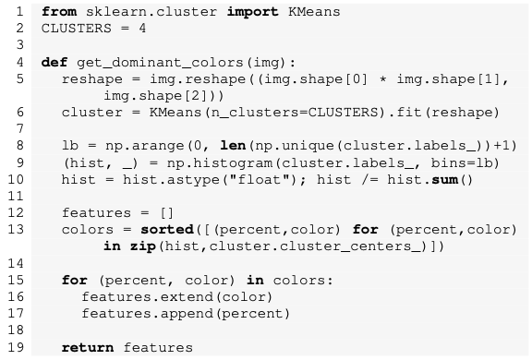
Results - Methodology
4. Color extraction
The K-means algorithm was used to extract the dominant colors from the images.
Listing 1. Function to extract the dominant colors from a single image
Figure 3. Sample rocks with their dominant colors in percentage order and their average color
Notes:
In this step, the dominant colors were extracted from the rock images. In Listing 1, the “get_dominant_colors” function receives the pixel values of an image to train the K-means algorithm with k clusters. In line 6, K-means works by separating the pixels of the image into 4 clusters of similarly colored pixels. The colors at each cluster center reflect the average value of the attributes of all members of a cluster. The percentage of a cluster is the number of pixels within that color cluster and is calculated in lines 8 to 10. Finally, the centroid of each cluster and its percentage are sorted in increasing order of percentage and added to a features list in lines 12 to 17. The returned list in line 19 contains the sixteen features: the four dominant colors represented by the three channels of the selected color format and the percentage of each dominant color (see Fig. 3).
In Listing 2, the processed data in RGB format is iterated in lines 4 to 6 and the dominant colors are extracted in line 5 with the function described in Listing 1. The colors are added to a new list of extracted colors in line 6. This process is also made for the CIELAB data in lines 8 and 9. Finally, the extracted colors in RGB and CIELAB formats are saved together with their respective rock label in different CSV files. These files were used in the next step to train the machine learning algorithms. The CSV files with the extracted dominant colors in RGB and CIELAB color spaces are available online8 , 9 .

Slide 18

Results - Methodology
5. Data normalization and label encoding
First, we divided the dominant color data into a training set of 80% and a testing set of 20%.
Second, we normalized the train and test data for data cleaning and better performance in model training.
Finally, we encoded the rock class labels transforming the labels into values from 0 to 3, representing gabbro, diorite, granodiorite, and granite, respectively.
Notes:
First, in this step we loaded the dominant colors data from the CSVs. The dominant colors and their percentage are the data features loaded into x, and the rock classes are the data labels loaded into y. Second, in order to train and test the models, the x and y data were divided into a training set of 80% and a test set of 20% using the “train_test_split” function of the model_selection class from Scikit-learn. Thereafter, we normalized the x data of train and test sets using the “MinMaxScaler” function imported from the preprocessing class of Scikit-learn. This function scales each feature to a given range of 0 to 1 for data cleaning and better performance in model training. Finally, we encoded the y data in order to train the machine learning models transforming the labels into values from 0 to 3 representing the four rock classes of plutonic rocks: gabbro, diorite, granodiorite, and granite, respectively. The encoding process was made with the “LabelEncoder” function of the preprocessing class imported from Scikit-learn module.

Slide 19

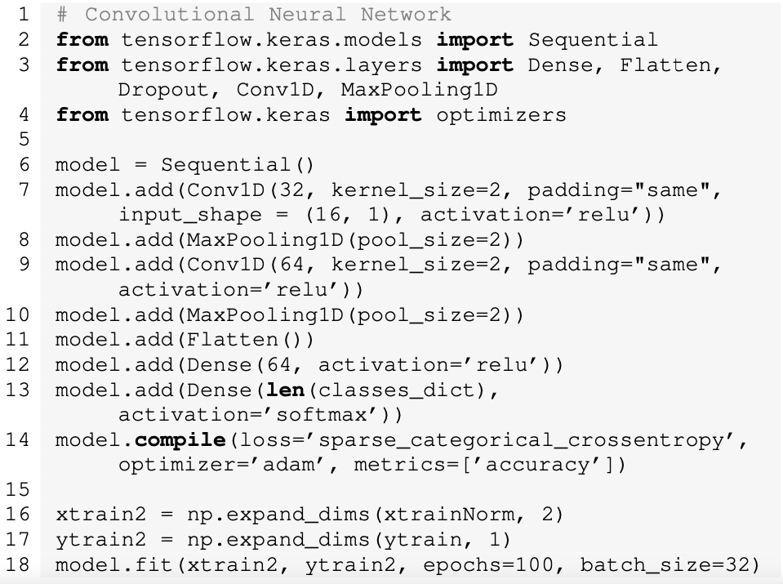
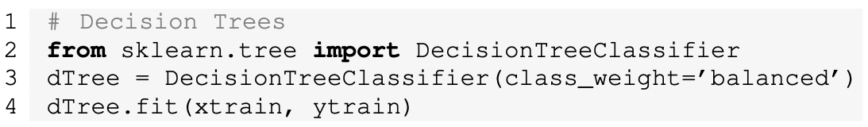
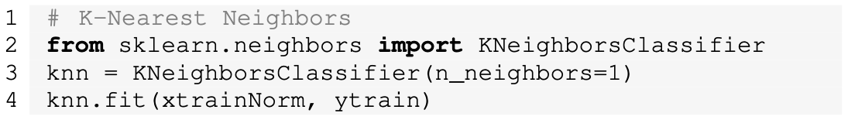
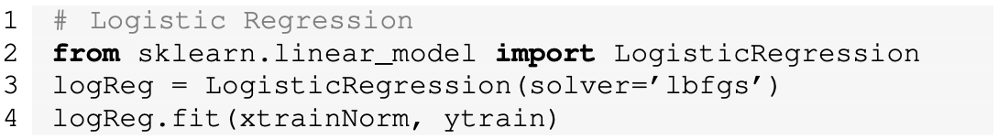
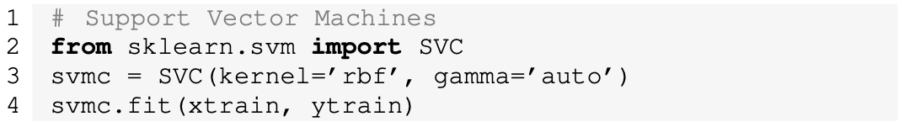
Results - Methodology
6. Training the different algorithms with the extracted dominant colors
Five machine learning models were trained using the RGB data and afterwards the CIELAB data: CNN, DT, KNN, LR, and SVM.
Listing 7. Configuration and training of CNN
Listings 3-6. Configuration and training of DT, KNN, LR, and SVM
Notes:
Five machine learning models were trained using the RGB data and afterwards the CIELAB data: CNN, DT, KNN, LR, and SVM. The notebooks showing the code for training and validation of the generated models with RGB and CIELAB data are available online10,11.
Listings 3-7 present the set and training process of the models. The CNN, KNN, and LR models were trained with the normalized data while the DT and SVM models with non- normalized data.
The proposed CNN model is a four-layer structure: two one- dimensional convolutional layers and two fully-connected layers. There is a maxpooling layer after each convolutional layer and a flatten layer is placed between the two convolutional layers and the fully connected layers.

Slide 20



Results - Methodology
7. Creation of the iOS application
The best model was exported with and deployed in an mobile application to make the classification of images of four classes of plutonic rocks namely diorite, gabbro, granite, and granodiorite in real time.
Notes:
The best model was exported with TensorFlow Lite and deployed in an iOS mobile application to make the classification of images of four classes of plutonic rocks namely diorite, gabbro, granite, and granodiorite in real time.
The main requirements to develop the application were the Xcode IDE, the Xcode command-line tools, a valid Apple Developer ID, and the CocoaPods dependency manager. The application was written mostly in Swift and uses the following two libraries to perform the extraction of the dominant colors and the rock image classification:
• The DominantColor13 dependency is an open source library written in Swift. It finds the dominant colors of an image using the K-means clustering algorithm.
• The TensorFlowLite Swift14 library is TensorFlow’s lightweight solution for Swift developers. It enables low- latency inference of on-device machine learning models with a small binary size and fast performance supporting hardware acceleration. For the application, Tensor- FlowLiteSwift pod name was added into the project’s Podfile, and from command line the library was resolved into the Xcode project by the CocoaPods dependency manager.
As a required step for the deployment of the model in the application, it was necessary to export the model by creating and training a concrete function in TensorFlow. This function calculates the Manhattan distance of a new data point to all the points in training data to select the label of the nearest point as the label of the new point. The last step in the model exportation was to create a graph of the trained model from the concrete function. That graph was exported in a TensorFlow Lite file. The source code of the creation and exportation of the model in TensorFlow is available online15.

Slide 21
Results
The following metrics were used in this project to evaluate the models:
$$\text{Recall}\text{ = }\frac{\text{TP}}{\text{TP}\text{+}\text{FN}}$$
"Recall = " "TP" /"TP+FN"
$${\text{F}}_{\text{1}} \text{score}\text{ =} \frac{\text{Precision}\text{ ∗ }\text{Recall}}{\text{Precision}\text{+}\text{Recall}}$$
"F" _"1" " score =" "Precision ∗ Recall" /"Precision+Recall"
$$\text{Accuracy}\text{ =} \frac{\text{Correct} \text{Predicitons}}{\text{Predictions} \text{Made}}$$
"Accuracy =" "Correct Predicitons" /"Predictions Made"
$$\text{Precision}\text{ = }\frac{\text{TP}}{\text{TP}\text{+}\text{FP}}$$
"Precision = " "TP" /"TP+FP"
Results
Notes:
The following metrics were used in this project to evaluate the models:
Accuracy is the ratio of the number of correct predictions made to the number of all predictions made [30].
Precision is the number of correct positives results, di- vided by the number of positive results predicted [30].
Recall is the number of correct positive results, divided by the number of all relevant samples (all the samples that should be classified as positive) [30].
F-score is the harmonic mean between precision and recall. This number, which is in the [0,1] range, indicates how precise the classifier is (precision) and how robust it is (recall). The greater the F1 score, the better the overall performance of the model [30].

Slide 22
Results - Results
Table 4. Results of the models in terms of accuracy, precision, recall, and F₁ score
The best results were for the KNN model using the CIELAB dominant colors data with an accuracy, precision, recall, and F₁ score of 93%.
Model | Accuracy | Precision | Recall | F₁ score
with CIELAB dominant colors
CNN | 0.81 | 0.82 | 0.82 | 0.81
DT | 0.68 | 0.68 | 0.69 | 0.68
KNN | 0.93 | 0.93 | 0.93 | 0.93
LR | 0.63 | 0.64 | 0.66 | 0.63
SVM | 0.81 | 0.82 | 0.82 | 0.80
With RGB dominant colors
CNN | 0.70 | 0.72 | 0.72 | 0.71
DT | 0.72 | 0.73 | 0.72 | 0.73
KNN | 0.79 | 0.80 | 0.79 | 0.79
LR | 0.63 | 0.64 | 0.65 | 0.62
SVM | 0.53 | 0.60 | 0.49 | 0.46
Table 5. Results of KNN for each rock class
Class | Precision | Recall | F₁ score
Diorite | 0.89 | 1.00 | 0.94
Gabbro | 0.93 | 1.00 | 0.96
Granite | 1.00 | 0.92 | 0.96
Granodiorite | 0.92 | 0.79 | 0.85
Notes:
Table IV shows the average accuracy, precision, recall, and F-score results of each model evaluated with the test sets of dominant colors in RGB and CIELAB color formats. The models generated with the CNN, KNN, LR, and SVM algorithms gave better results with CIELAB data than with RGB data. The results with the DT model were better in RGB. The best results were for the KNN model using the CIELAB dominant colors data with an accuracy, precision, recall, and F-score of 93%. The training time of the KNN model was 4.33 minutes.
Table V shows the evaluation results of the KNN model for each rock class in terms of precision, recall, and F-score using the CIELAB dominant colors data.

Slide 23
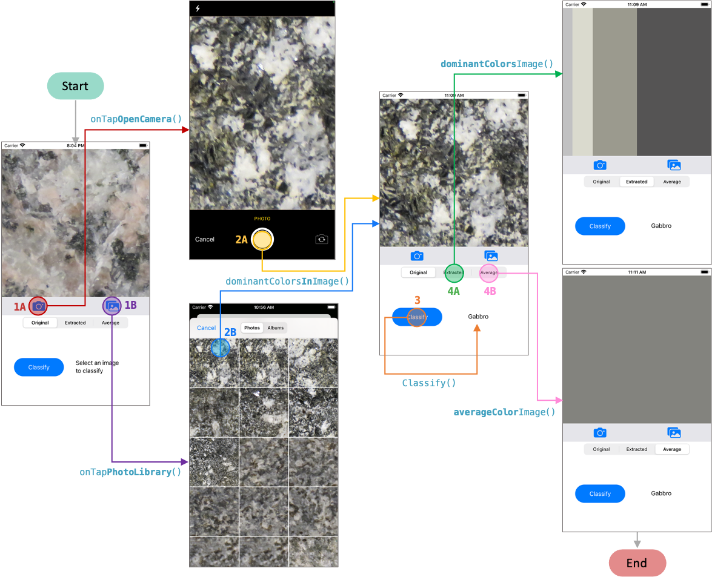
Results - Results
The model generated with KNN was deployed on the iOS application
Figure 4. Application Workflow
Notes:
The KNN model was deployed on the iOS application (see Fig. 4). There are two ways to make the classification of new rocks on this application. The first way is taking a picture with the “Open Camera” button shown in step 1A of Fig. 4. When camera opens, the new scene of step 2A appears and displays the device camera. The second way is choosing a photo from the “Photo Library”. The “Open Library” button in step 1B opens the photo library of the device as shown in step 2B. The extraction of the dominant colors is performed after the image was loaded with the “dominantColorsInImage” function. Thereafter, the “Classify” button in step 3 is enabled to classify the new rock image into: gabbro, diorite, granodiorite, or granite. When the button is pressed the extracted colors are converted to CIELAB and sorted in ascending order by their percentage of pixels in the image. These colors and their percentage are used as the input tensor for the model imported from the “tflite” file containing its graph. Optionally, the dominant colors and the average colors of the selected image can be displayed pressing the “Extracted” and “Average” buttons of steps 4A and 4B respectively.
At runtime, the classification with the KNN exported model took 339.87 milliseconds. The size of the model was 0.018 MB. The video demonstration of the mobile application is available online16 .

Slide 24
Results - Discussion
Discussion
Table 6. Comparison of the average accuracies of this research with our previous work
Metrics | KNN of this work with four dominant colors | CNN of our previous work [2] with all the features used during training
Accuracy | 93 % | 95 %
Precision | 93 % | 96 %
Recall | 93 % | 95 %
F₁ score | 93 % | 95 %
Training time | 4.33 min | 120 min
Execution time | 339.87 ms | 353.74 ms
File size | 0.018 MB | 2.6 MB
Notes:
Five machine learning algorithms were trained with just the four dominant colors extracted from images of plutonic rocks. The best model was found with the KNN algorithm trained with the dominant colors in the CIELAB color format of 283 images. The KNN model has an accuracy, precision, recall, and F-score values of 93%. Table VI presents the comparison of these results and the results of the CNN of our previous work [2] using all the image features. Although in our previous work the results were 2% better in terms of accuracy, recall, and F-score, and 3% in precision, it is noteworthy that dominant colors approach did not apply data augmentation technique as in our previous work. Furthermore, a training time of 0.068 seconds, an execution time of 339.87 milliseconds, and a file size of 0.018 MB were obtained in this work compared with 2 hrs, 353.74 ms, and 2.6 MB in our previous work. These computational metrics were better with the dominant colors approach being the training and execution times 96% and 4% faster than in our previous work, and the file size 99.3% lighter.

Slide 25

Conclusions & Future
Work

Slide 26
Conclusions & Future Work
The dominant colors approach can be useful in classifications where color is important to differentiate images.
As future work, the datasets for training and validation will be extended with a larger number of plutonic rock images taken in the field, rather than in the lab. Also, images will be taken under different conditions and the mobile application will be tested in the field under several conditions.
Notes:
This paper proposed color-based feature extraction in im- ages for training several machine learning models. The best validation results were for the model generated using KNN trained with 283 images in the CIELAB color space giving accuracy, precision, recall, and F-score average values of 93%. The dominant colors approach can be useful in classifications where color is important to differentiate images. CIELAB color format is an excellent option to do this. In addition, feature reduction can be applied when a quicker and lighter solution is needed.
As future work, the datasets for training and validation will be extended with a larger number of plutonic rock images taken in the field, rather than in the lab. Also, images will be taken under different conditions – different distances, angles, and lighting effects, e.g., blue vs. cloudy sky, with weathering or alteration, shadows, vegetation, and moss. Also, the mobile application will be tested in the field under several conditions.

Slide 27
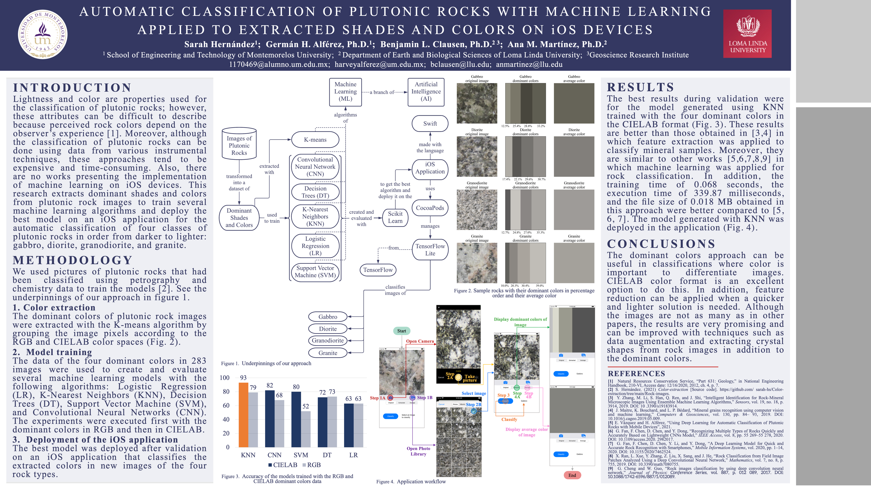
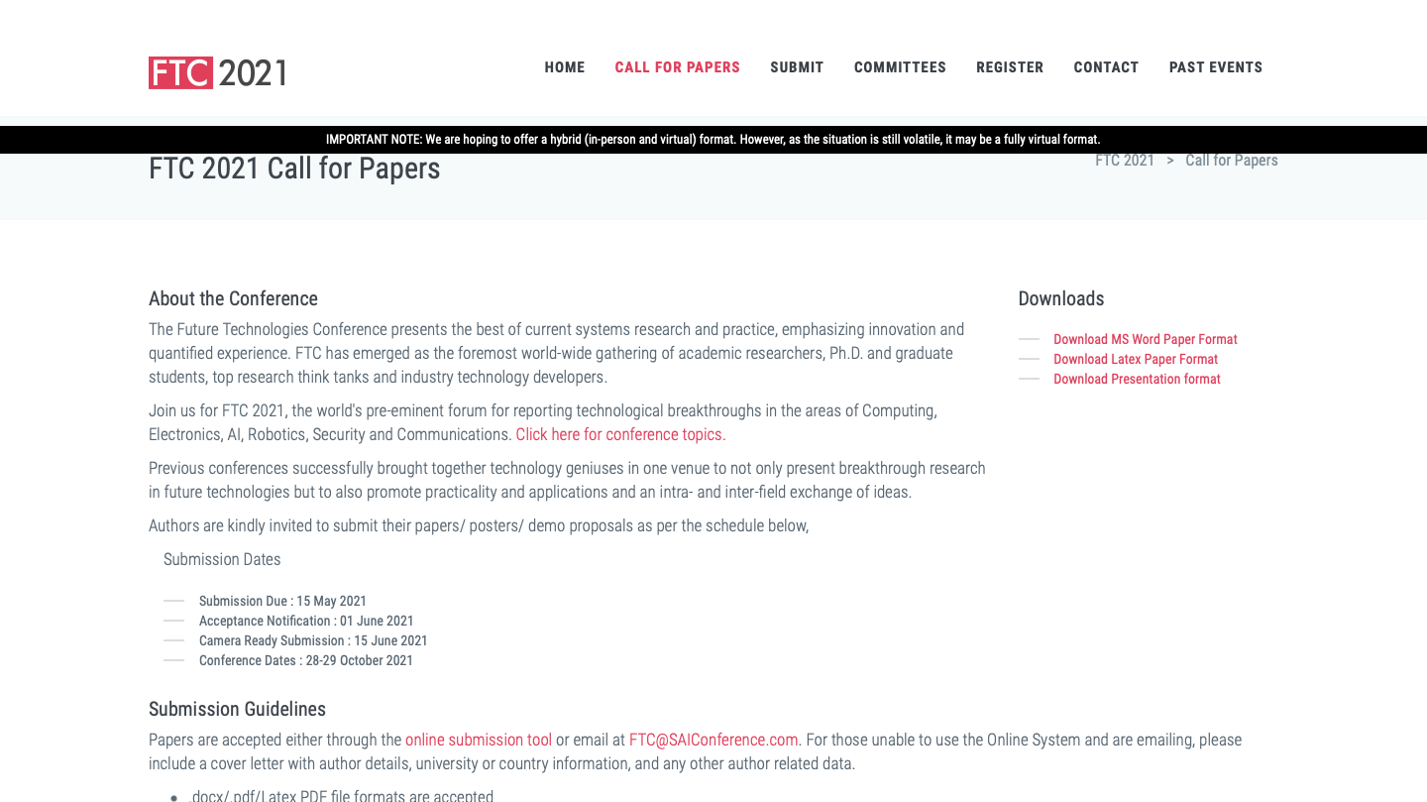
THIS PROJECT WILL BE PRESENTED IN A POSTER CONFERENCE OF THE GEOLOGICAL SOCIETY OF AMERICA (GSA) THIS MAY 2021.
ALSO, WE AND THE LOMA LINDA UNIVERSITY TEAM SENT AN ARTICLE WITH THESE RESULTS TO THE FUTURE TECHNOLOGIES CONFERENCE (FTC), VANCOUVER, CANADA. IT HAS BEEN ACCEPTED TO BE PRESENTED ON OCTOBER 2021.

Slide 28
THANK YOU!

Slide 29
THANK YOU!

